Slide 1
Sequence Alignment vs Databases
Dr. Muhammad Tahir
Assistant Professor
COMSATS University Islamabad,
Attock Campus

Slide 2
Sequence Similarity
Two protein sequences with more than 25 % identity (over 100 amino acids ) are homologues
Two DNA sequences with more than 70 % identity (over 100 nucleotides) are homologues
Homologous sequences have
A common ancestor (proteins and DNA)
A similar 3D structure (proteins)
Often a similar function (proteins)

Slide 3
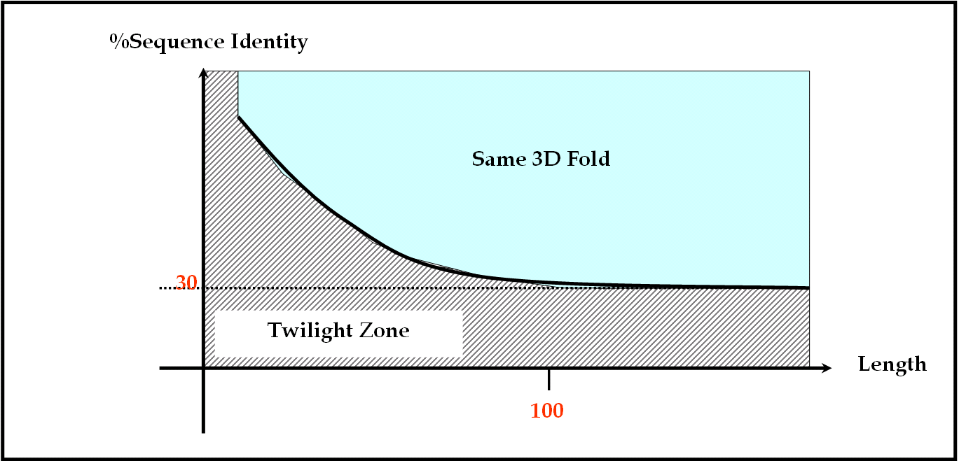
Homology
When two proteins have less than 25% identity
They can be homologous or non-homologous
Within this range of identity, it’s impossible to say which is true
This range of identity is called the “Twilight Zone”

Slide 4
Homology, Similarity, and Identity
Identity is a measure made on an alignment
Sequence A can be “32 % identical to” Sequence B
Similarity is a measure of how close two amino acids are to identical
For instance, isoleucine and leucine are similar
Homology is a property that exists or does not exist
Sequence A IS or IS NOT homologous to Sequence B
Sequence A cannot be “40% homologous to” B
Homology is established on the basis of measured similarity or identity

Slide 5
How to Establish Homology
Compare Protein A with every other protein in a database such as Swiss-Prot
Identify a Protein B that is 40% identical to your protein
Specialists prefer using E-values but the idea is the same (more on this in a minute)
You can conclude that A and B are probably homologous if they are very similar
It’s like saying, “John and Nancy are probably brother and sister because they are very similar.”
If you know the structure or the function of B, then A and B probably have the same structure

Slide 6
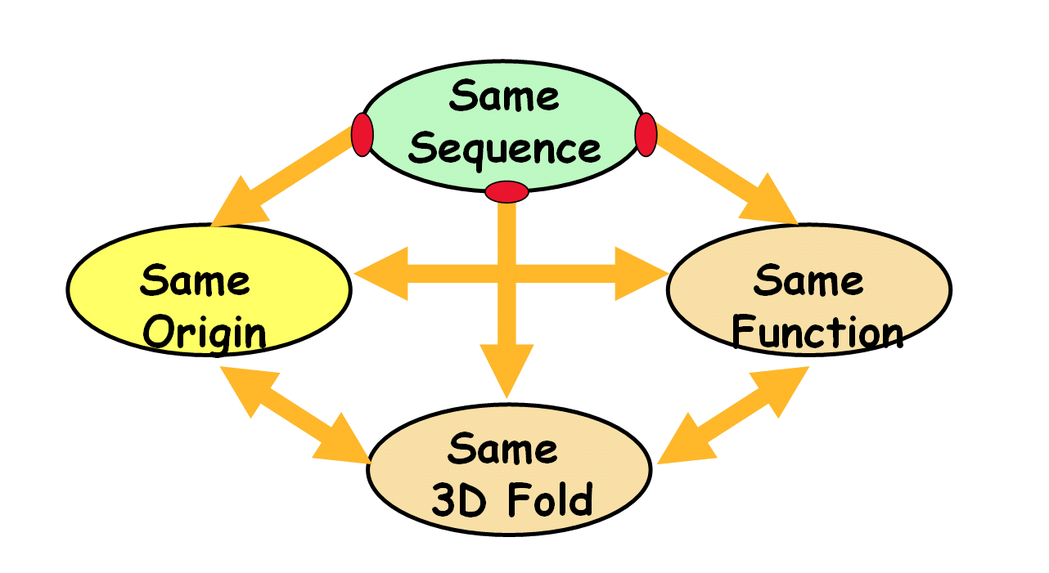
In-silico Biology
When establishing that two proteins (A and B) are homologous, you can extrapolate everything you know from one to the other.
It’s like making a virtual experiment.
This is in-silico biology!

Slide 7
BLAST
BLAST: Basic Local Alignment Search Tool
BLAST is a tool for comparing one sequence with all the other sequences in a database
BLAST can compare
DNA sequences
Protein sequences
BLAST is more accurate for comparing protein sequences than for comparing DNA sequences

Slide 8
BLAST (cont’d.)
BLAST makes local alignments
It only aligns what can be aligned
It ignores the rest
BLAST is very fast
You need only a few minutes to search Swiss-Prot on a standard PC
Many BLAST flavors are available for a variety of tasks

Slide 9
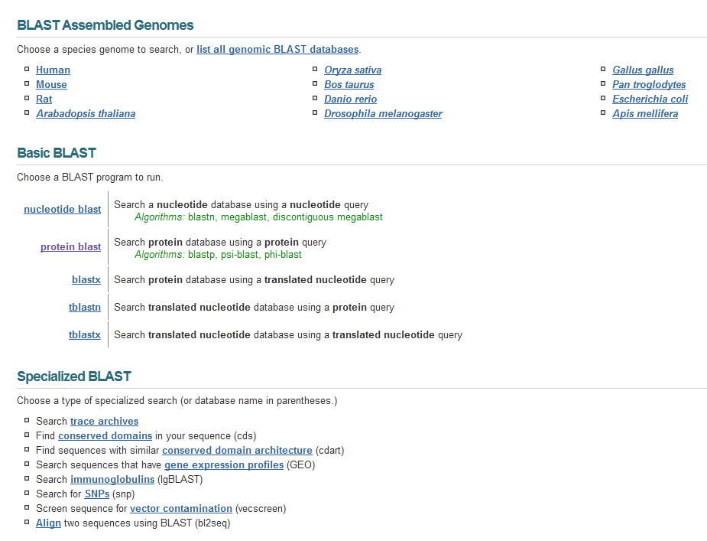
Many BLAST Flavors . . .

Slide 10
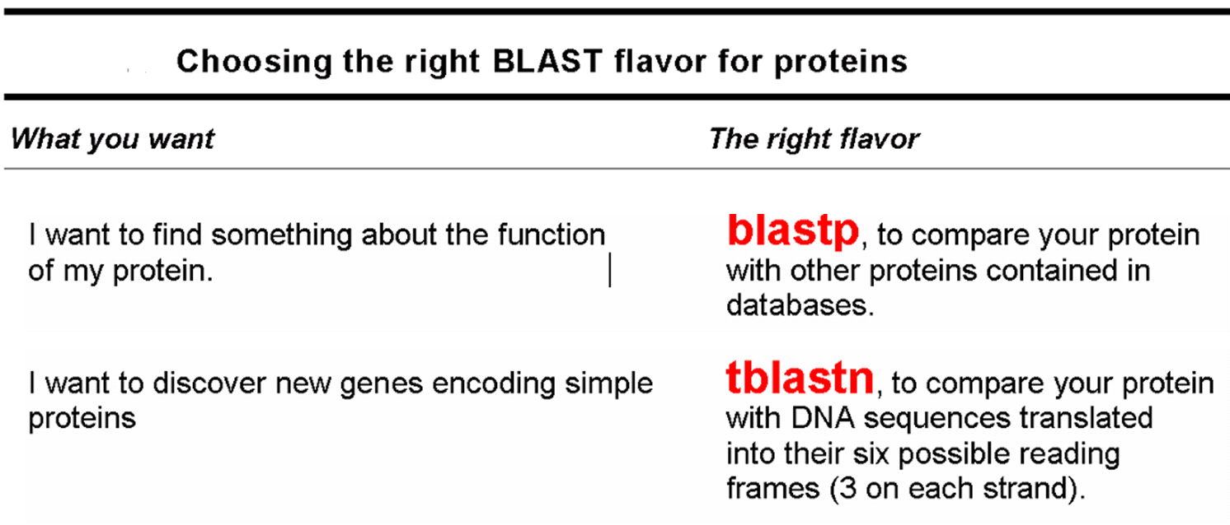
BLASTing a Protein Sequence

Slide 11
Running blast
Choose one of the public servers
NCBI www.ncbi.nlm.nih.gov/blast
EBI www.ebi.ac.uk/blast
EMBNet www.expasy.ch/blast
https://blast.ncbi.nlm.nih.gov/Blast.cgi (Recent Updated)
Select a database to search:
NR to find any protein sequence
Swiss-Prot to find proteins with known functions
PDB to find proteins with known structures
Cut and paste your sequence
Click the BLAST button

Slide 12
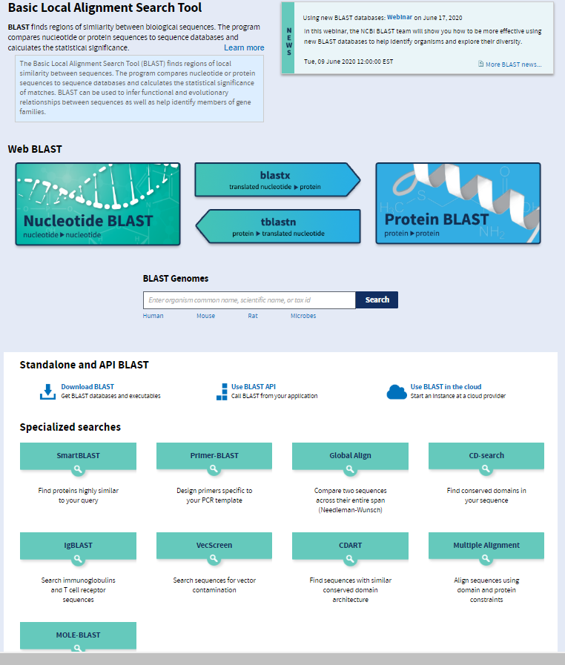
https://blast.ncbi.nlm.nih.gov/Blast.cgi

Slide 13
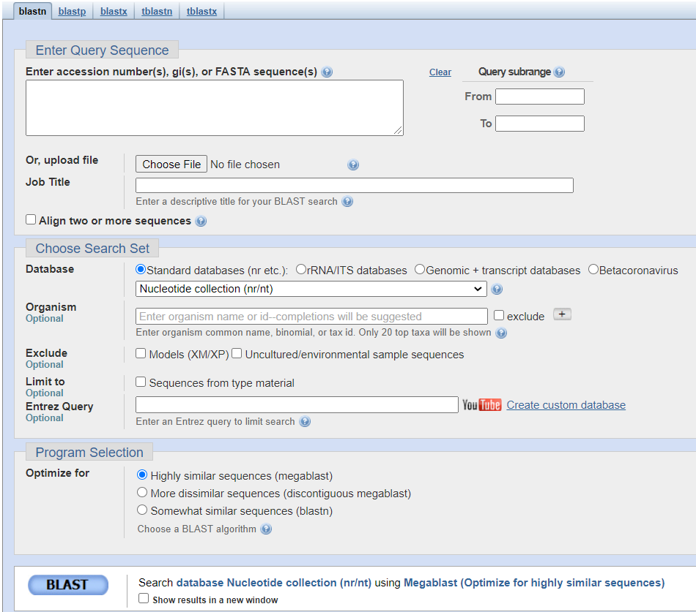
Blastn Interface

Slide 14
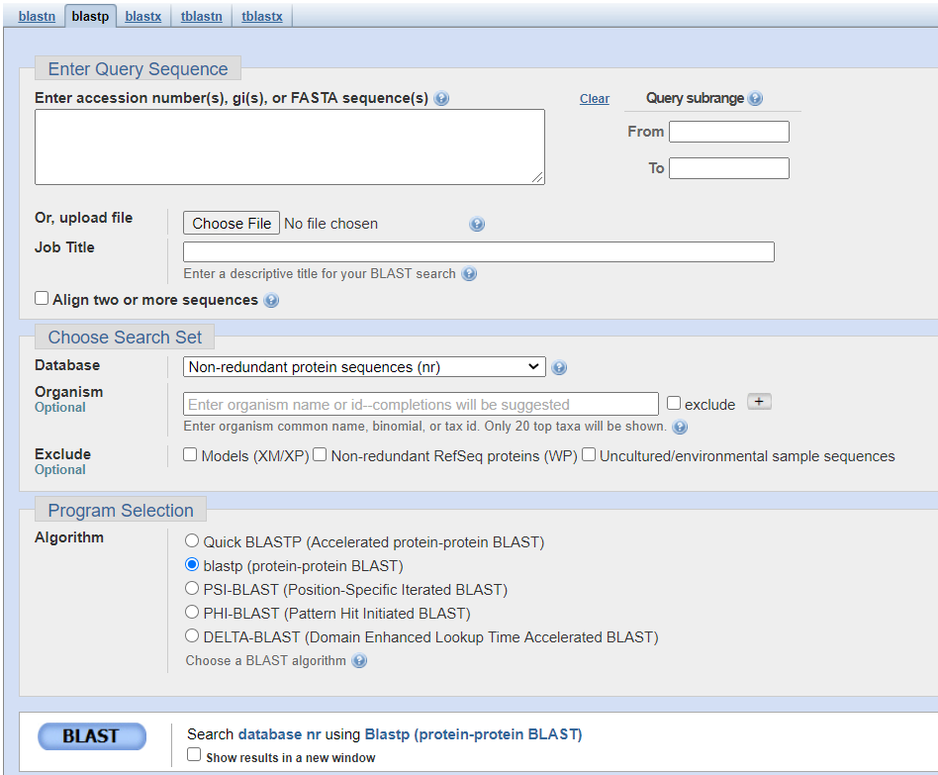
Blastp Interface

Slide 15
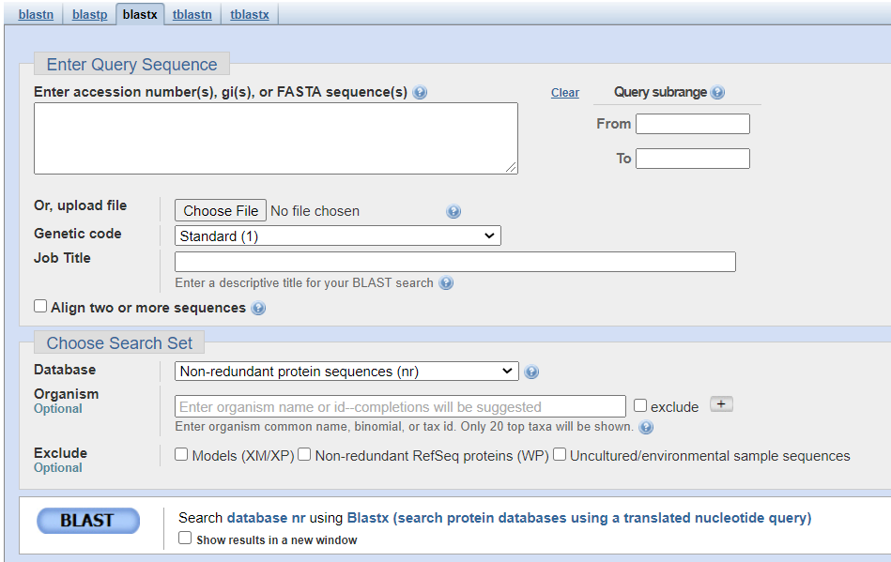
Blastx Interface

Slide 16
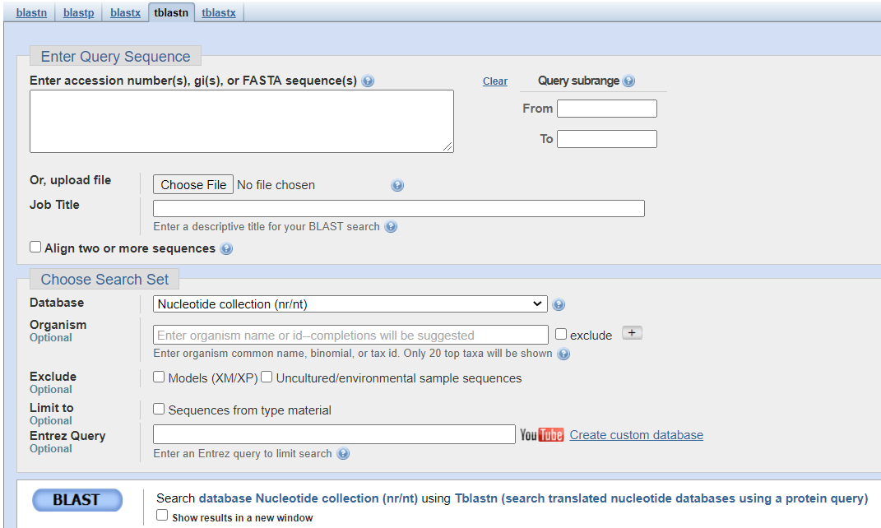
tBlastn Interface

Slide 17
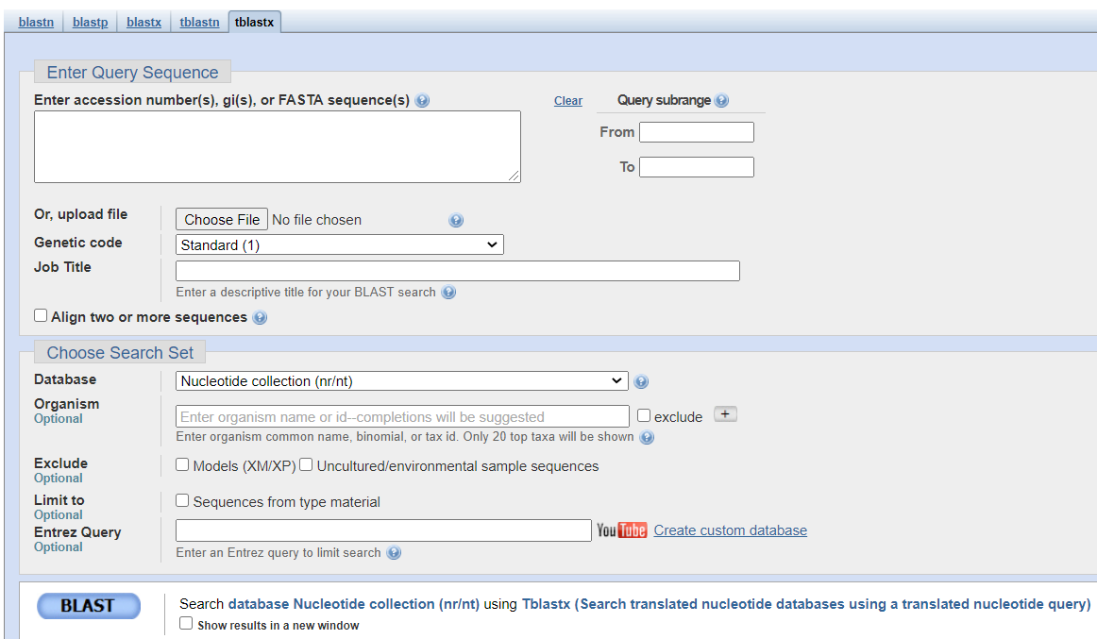
tBlastx Interface

Slide 18
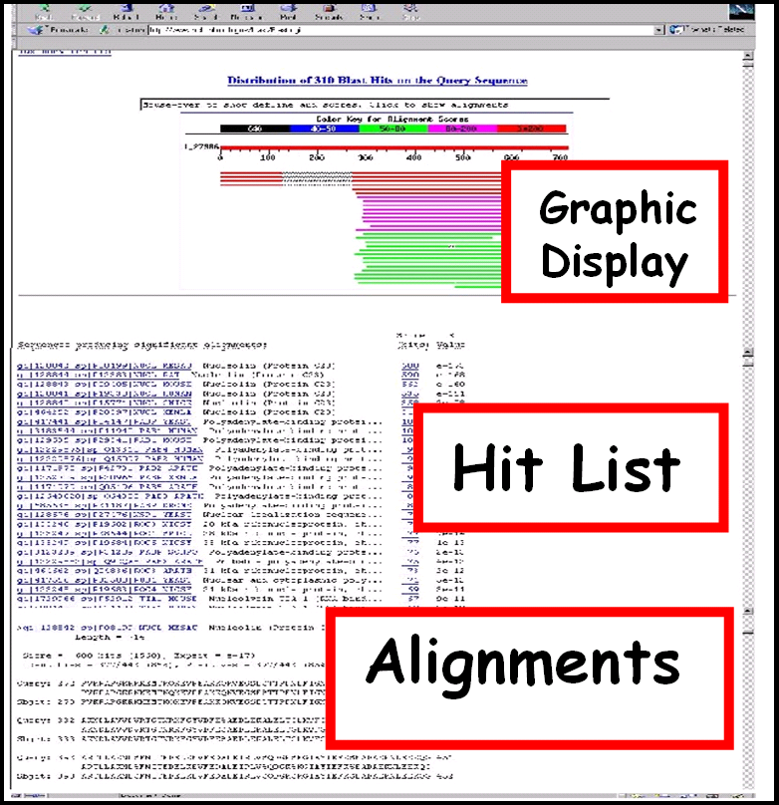
Reading BLAST Output
Graphic Display
Overview of the alignments
Hit List
Gives the score of each match
Alignments
Details of each alignment

Slide 19
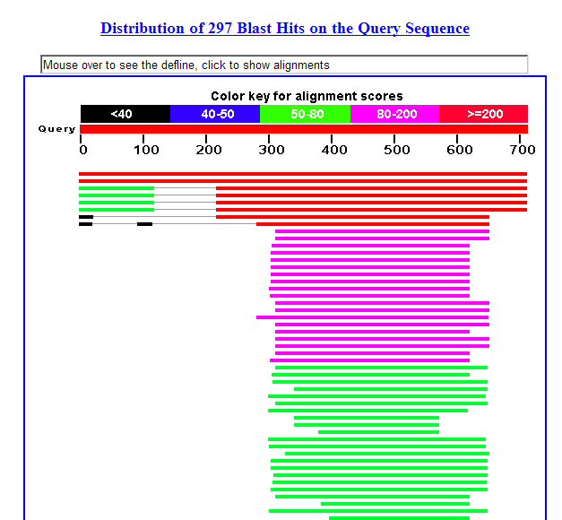
The Graphic Display
The Horizontal Axis (0-700) corresponds to your protein (query)
Color codes indicate that match’s quality
Red: very good
Green: acceptable
Black: bad
Thin lines join independent matches on the same sequence

Slide 20
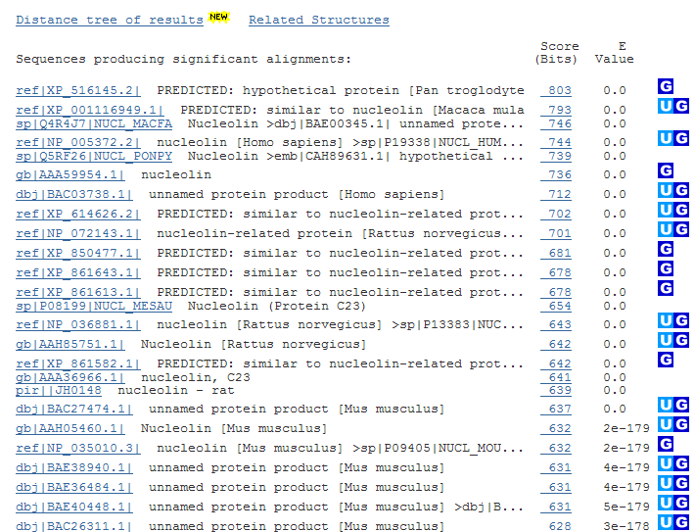
The Hit List
Sequence accession number
Depends on the database
Description
Taken from the database
Bit score
High bit score = good match
E-Value
Low E-value = good match
Links
Genome
Uniref, database of transcripts

Slide 21
The E-Values
E-value means expectation value
The E-value is the measure most commonly used for estimating sequence similarity
How many times is a match at least as good expected to happen by chance ?
This estimate is based on the similarity measure
If a match is highly unexpected, it probably results from something other than chance
Common origin is the most likely explanation
This is how homology is inferred

Slide 22
Which Value for Your E-Values ?
Low E-value ⬄ good hit
1 = bad e-Value
10^{e-3} = borderline E-value
10^{e-4} = good E-value
10^{e-10} = very good E-value
E-values lower than 10^{e-4} indicate possible homology
E-values higher than 10^{e-4} require extra evidence to support homology

Slide 23
Why Use E-Values?
E-values make it possible to compare alignment of different lengths
E-values are used by most sequence comparison programs
PSI-BLAST
Domain Search
FASTA
E-values always have the same meaning
You can compare the output of different programs
Notes:
Non-redundant protein sequences (nr) using PSI-BLAST (Position-Specific Iterated BLAST) Show results in a new window

Slide 24
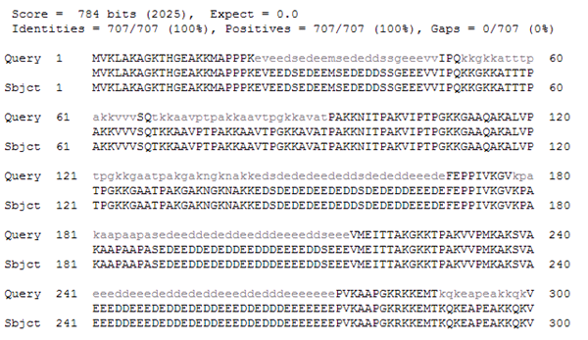
The Alignments
Look for clusters of identity
Gray residues are low-complexity regions
Grayed-out regions have been removed from your sequence to avoid false hits

Slide 25
BLASTing DNA Sequences
The BLAST program you need depends on your DNA sequence
Coding DNA
Non Coding DNA
BLASTing DNA sequences is less accurate than BLASTing protein sequences
If your sequence is coding, blastx and tblastx will translate it for you on its 6 possible reading frames

Slide 26
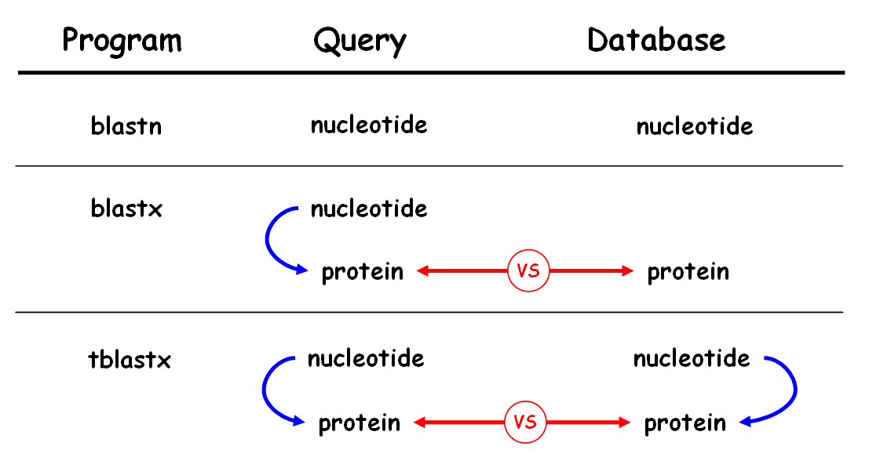
BLASTing DNA Sequences

Slide 27
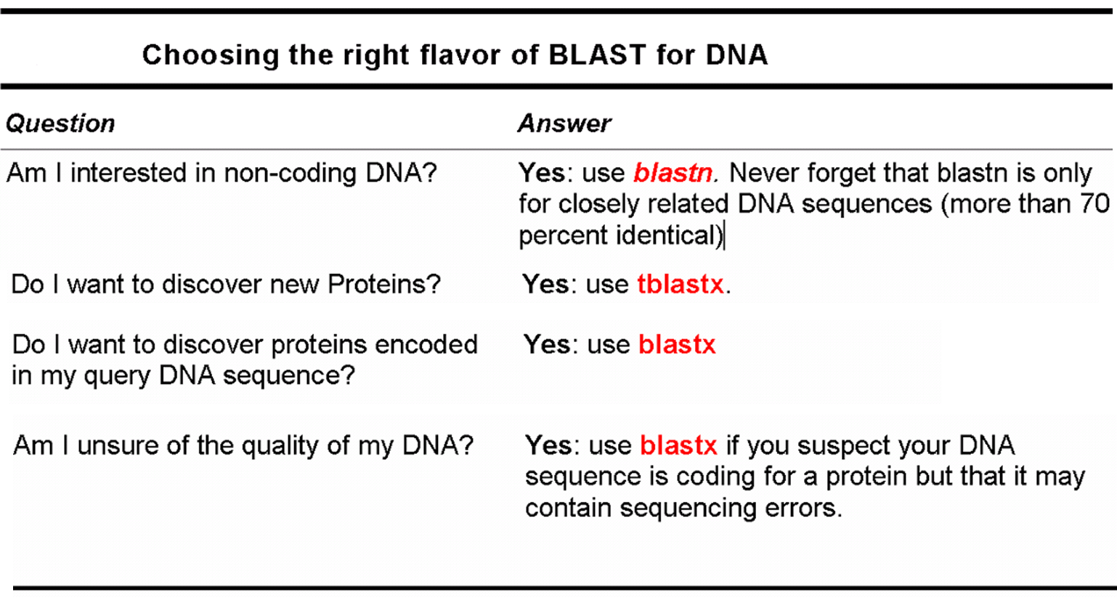
Asking the Right Question with BLAST

Slide 28
The BLAST Way of Doing Things
The original BLAST paper is the fourth-most-cited scientific publication
Cited by 84627 citations for BLAST (Dated 12 June,2020)
Cited by 73793 citations for PSI-BLAST (Dated 12 June,2020)
BLAST has changed many aspects of modern biology
The following slides show more BLAST procedures
They are not necessarily the best procedures
They are effective ways of getting the job done on the spot

Slide 29
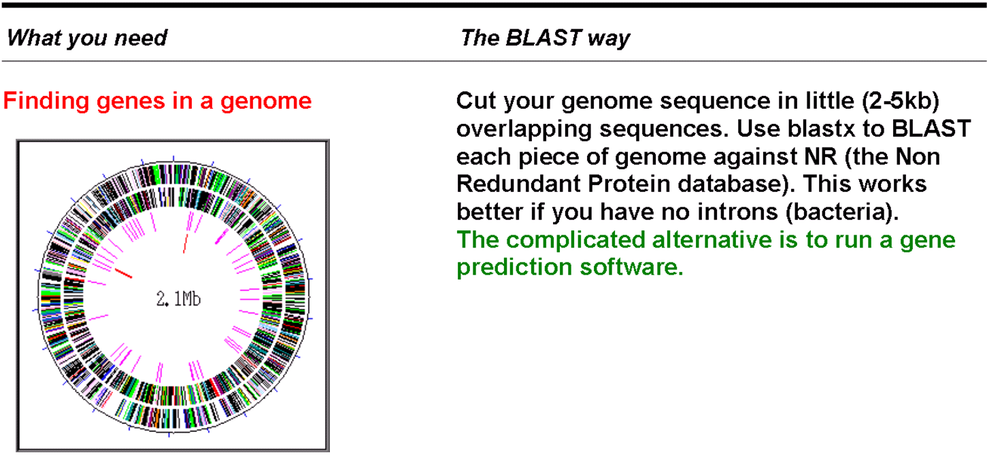
Gene-Hunting with BLAST
Predicting a Protein Function
Cut your genome sequence in little (2~5Kb) overlapping sequences. Use blastx to BLAST each piece of genome against NR (the Non Redundant protein database). This works better if you have no introns (bacteria).
The complicated alternative is to run gene-prediction software program.

Slide 30
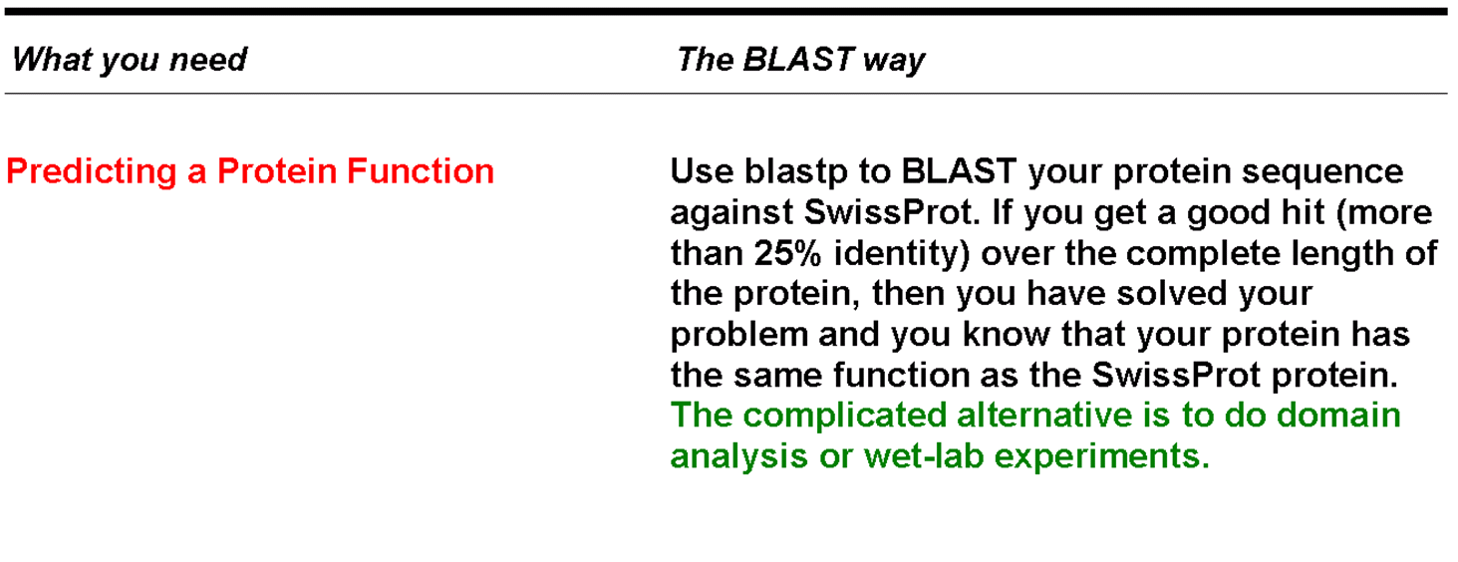
In-silico Analysis with BLAST
Use blastp to BLAST your protein sequence against SWISS-PROT. If you get a good hit (more than 25 percent identity) over the complete length of the protein, you’ve solved your problem and you know that your protein has the same function as the SWISS-PROT protein.
The complicated alternative is to conduct domain analysis or wet-lab experiments
Predicting a Protein Function

Slide 31
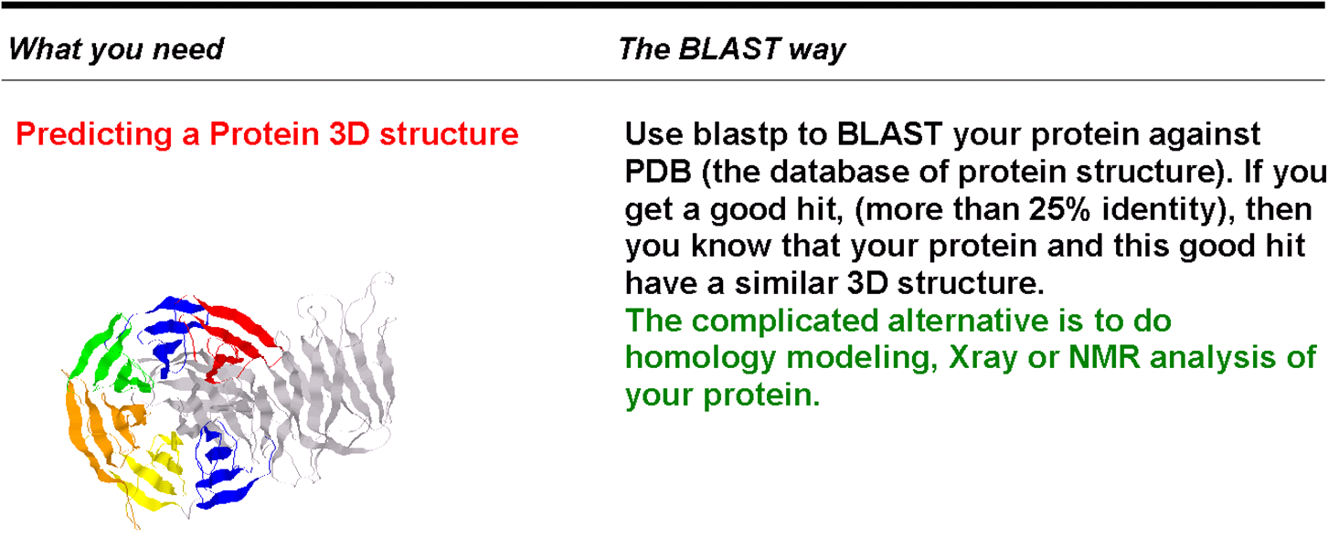
Structural Analysis with BLAST
Predicting a Protein 3D Structure
Use blastp to BLAST your protein against PDB (the database of protein structure). If you get a good hit (more than 25 percent identity), you know that your protein and this good hit have a similar 3-D structure.
The complicated alternative is to do Homology Modeling, X-ray or NMR analysis of your protein
Notes:
Nuclear Magnetic Resonance (NMR) spectroscopyis an analytical chemistry technique used in quality control and reserach for determining the content and purity of a sample as well as its molecular structure.

Slide 32
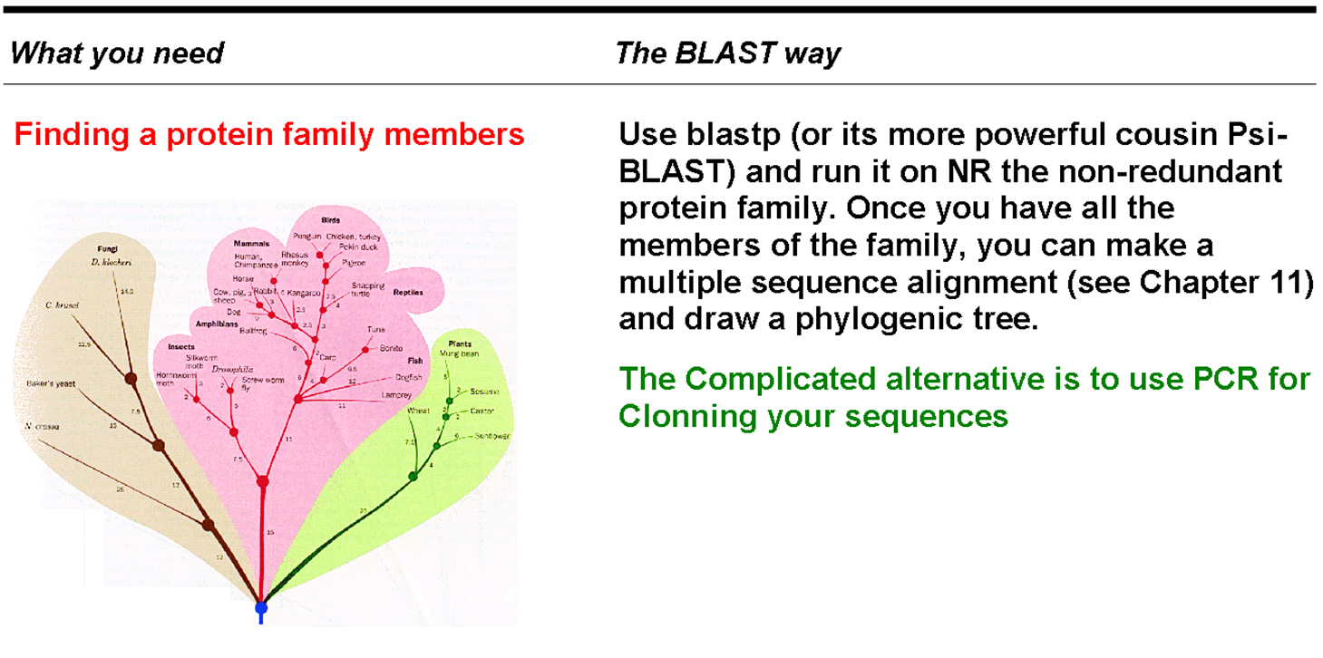
Gathering Members of a Protein Family
Finding Protein Family Members
Use blastp (or its more powerful cousin PSI-BLAST) and run it against NR (the non-redundant protein family). After you have all the members of the family, you can make a multiple-sequence alignment (see Chapter 9) and draw a phylogenetic tree.
The complicated alternative is to use PCR for cloning your sequences

Slide 33
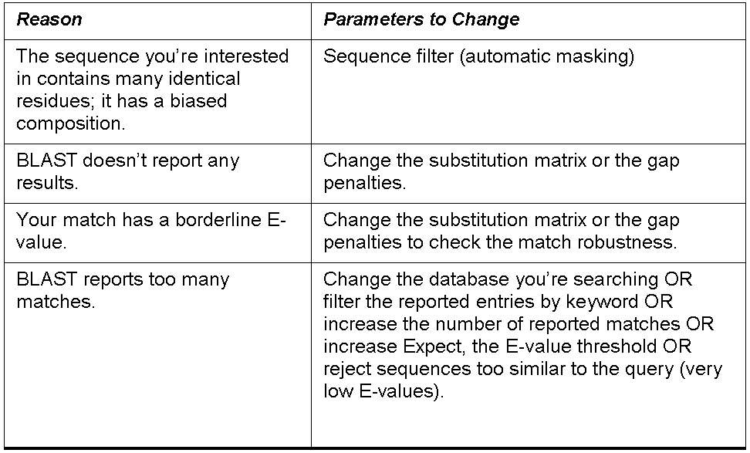
Some Reasons for Changing the Default Parameters

Slide 34
PSI-BLAST
PSI-BLAST is Position-Specific Iterated BLAST
More sensitive than BLAST: finds matches BLAST would not find
More specific than BLAST: reports fewer false matches
A bit slower than BLAST
PSI-BLAST finds remote homologues
Will let you identify very distant members of your protein family
PSI-BLAST uses the results of each iteration to increase its specificity

Slide 35
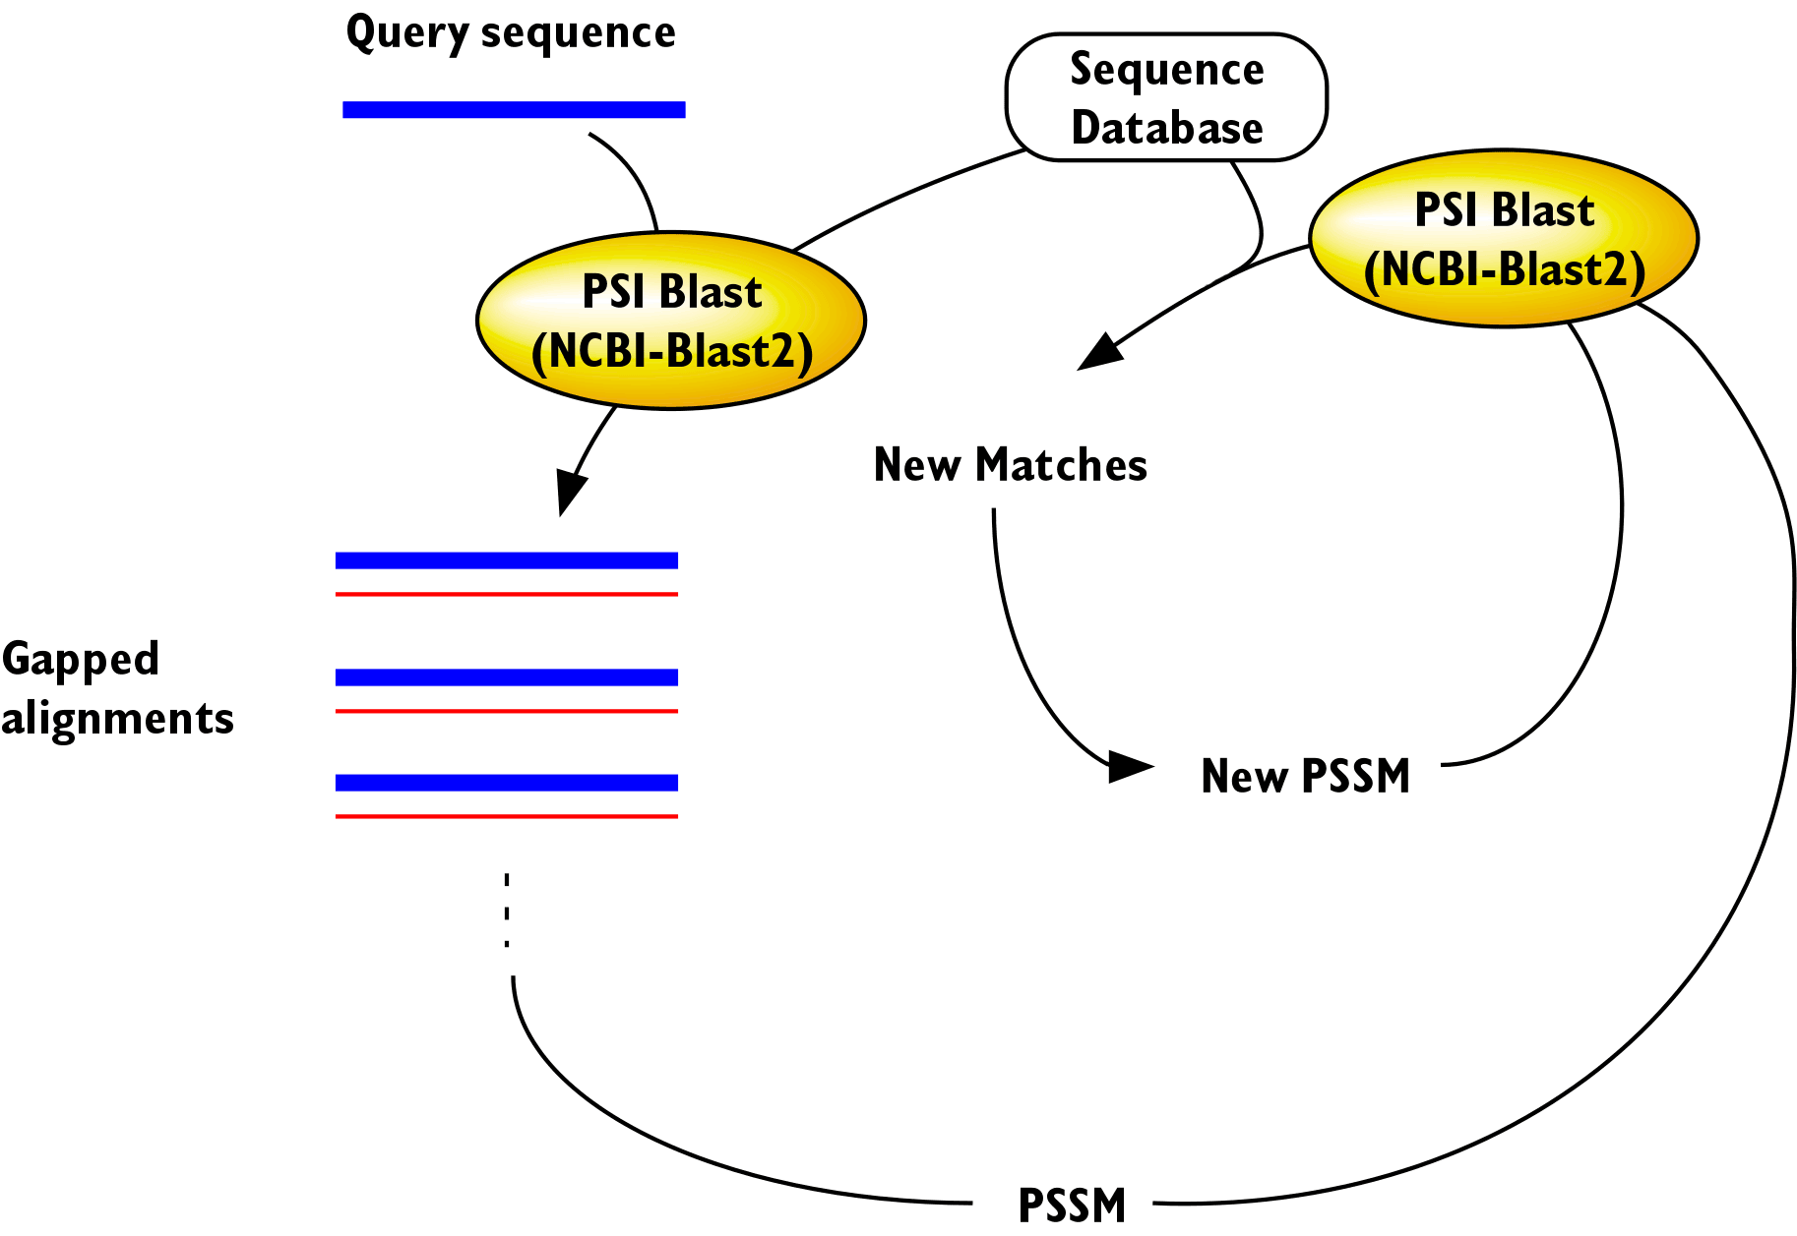
PSI-BLAST Iterations
PSI-BLAST uses the best results of the first iteration to build a profile (PSSM)
PSI-BLAST uses the profile to re-scan the database
PSI-BLAST keeps re-scanning until it stops finding new matches

Slide 36
Some Tips for Using PSI-BLAST
If your protein is multi-domain, search one domain at a time
PSI-BLAST is slower than normal BLAST because of the iterations
You can feed PSI-BLAST with your own position-specific scoring matrix (PSSM)
Use the NCBI server for this purpose
Notes:
position-specific scoring matrix (PSSM)

Slide 37
Going Farther
Each BLAST online server is unique
Shop around to find the right database
If you need to look for exact matches between a sequence and a genome use BLAT
No it’s not a typo
You can find it at genome.ucsc.edu
If you want something more accurate than BLAST, use Smith and Waterman
It’s also slower than BLAST
You can find it at www-btls.jst.go.jp

